Slide 1
Current Uses and Outcomes of Hematopoietic Cell Transplantation (HCT) in the US
Notes:
INTRODUCTION: The Summary Slides are an annual report on data submitted to the CIBMTR by centers in US and describes information related to practices and general survival outcomes after hematopoietic cell transplantation. The current edition includes transplants performed prior to 2021.
Slides 2 to 69 exhibit data on frequency of transplants according to transplant type, donor, patient age, graft source, GVHD prophylaxis, disease, causes of death, conditioning regimen, and race and/or ethnicity. All frequencies represent first autologous and allogeneic transplants registered with the CIBMTR during the period.
Slides 70 to 113 include overall survival outcomes according to age, donor type, disease, disease status, year of transplant, and race and ethnicity. Comparisons across survival curves are univariate and do not adjust for all potentially important factors; consequently, results should be interpreted cautiously.
Acute myelogenous leukemia (AML), and acute lymphocytic leukemia (ALL) have disease status at HCT classified as CR1, CR2+ (2nd or subsequent complete remission) and relapse/ never in CR (includes primary induction failure).
Myelodysplastic syndromes (MDS) stage is divided into
Low risk (refractory anemia [RA] or refractory anemia with ringed sideroblasts [RARS], refractory cytopenia with unilineage dysplasia [RCUD], refractory cytopenia with multilineage dysplasia [RCMD], MDS with isolated del(5q))
High risk (refractory anemia with excess blasts [RAEB] or chronic myelomonocytic leukemia [CMML]) disease).
Myeloproliferative neoplasms (MPN) include myelofibrosis, polycythemia vera, essential thrombocythemia, chronic myelomonocytic leukemia, chronic myeloproliferative disease-unclassifiable, chronic neutrophilic leukemia, chronic eosinophilic leukemia and MPN-not otherwise specified.
Chronic myelogenous leukemia (CML) have disease stage classified as hematologic CR, chronic phase, accelerated phase or blast crisis.
Lymphomas are classified according to sensitivity to prior chemotherapy (chemosensitive or chemoresistant).
The classification of conditioning regimen intensity is based on the agents, doses and schedules used. Several classification systems are available, and for this report we used a composite classification. Cases defined as reduced-intensity by the transplant center were classified as such. Cases without such information and with available data on chemotherapy agents, radiation and doses, were classified according to the CIBMTR operational definition of conditioning regimen intensity:
Myeloablative conditioning regimen: regimens with total body irradiation doses of ≥500 cGY, single fractionated doses of ≥800 cGY, busulfan doses of >9mg/kg oral or Bu >= 7.2 mg/kg IV, or melphalan doses of >150 mg/m² given as single agents or in combination with other drugs.
Reduced-intensity conditioning/Non-myeloablative regimen: regimens with lower doses of total body irradiation, fractionated radiation therapy, busulfan, melphalan, Thiotepa and Treosulfan than those used to define a myeloablative conditioning regimen (above).
References for conditioning intensity:
1. Bacigalupo A, Ballen K, Rizzo D, Giralt S, Lazarus H, Ho V, et al. Defining the intensity of conditioning regimens: working definitions. Biology of blood and marrow transplantation : journal of the American Society for Blood and Marrow Transplantation. 2009;15(12):1628–1633. doi: 10.1016/j.bbmt.2009.07.004.
2. Giralt S, Ballen K, Rizzo D, Bacigalupo A, Horowitz M, Pasquini M, et al. Reduced-intensity conditioning regimen workshop: defining the dose spectrum. Report of a workshop convened by the center for international blood and marrow transplant research. Biology of blood and marrow transplantation : journal of the American Society for Blood and Marrow Transplantation. 2009;15(3):367–369. doi: 10.1016/j.bbmt.2008.12.497.
Auletta J.J., Kou J., Chen M., Shaw B.E. Current use and outcome of hematopoietic stem cell transplantation: CIBMTR summary slides, 2021. Available at: http://www.cibmtr.org

Slide 2
Relative Proportion of Allogeneic HCTs by Indications in the US by Race and Ethnicity, 2020
Notes:
Slide 54
Race and Ethnicity in ‘Others’ category includes non-Hispanic Native Hawaiian or other Pacific Islander (AML n=5; ALL n=4; MDS n=5; Aplastic anemia n=2; Non-malignant disease n=1 ), American Indian or Alaska Native (AML n=9; ALL n=12; MDS n=3; Aplastic anemia n=3; Non-malignant disease n=3), More than one race (AML n=16; ALL n=6; MDS n=5; Aplastic anemia n=7; Non-malignant disease n=8), and Non-resident of the US (AML n=14; ALL n=18; MDS n=9; Aplastic anemia n=4; Non-malignant disease n=20).
Non-malignant disease includes Inherited abnormalities erythrocyte differentiation or function (n=191), Severe combined immunodeficiency (SCID) and other immune system disorders (n=163), Inherited abnormalities of platelets (n=5), Inherited disorders of metabolism (n=49), Histiocytic disorders (n=49), and Autoimmune Diseases (n=5).

Slide 3
Relative Proportion of Autologous HCTs by Indications in the US by Race and Ethnicity, 2020
Notes:
Slide 55
Race and Ethnicity in ‘Others’ category includes non-Hispanic Native Hawaiian or other Pacific Islander (MM/PCDs n=10; HL n=1; FL n=0; DLBCL n=0; MCL n=1), American Indian or Alaska Native (MM/PCDs n=37; HL n=2; FL n=0; DLBCL n=8; MCL n=3), More than one race (MM/PCDs n=15; HL n=3; FL n=0; DLBCL n=3; MCL n=0), and Non-resident of the US (MM/PCDs n=22; HL n=2; FL n=0; DLBCL n=2; MCL n=1).

Slide 4
Relative Proportion of Allogeneic HCTs in the US by Race and Ethnicity
Notes:
Slide 56: Trends in allogeneic HCT by race and ethnicity are stable over time

Slide 5
Relative Proportion of Autologous HCTs in the US by Race and Ethnicity
Notes:
Slide 57: Trends in autologous HCT show a small but steady increase in HCT in Hispanic and NHB patients

Slide 6
Relative Proportion of Matched Related Donor HCTs in the US by Race and Ethnicity
Notes:
Slide 58: Trends in MRD HCT show a small but steady increase in HCT in Hispanic patients over time

Slide 7
Relative Proportion of Matched Unrelated Donor HCTs in the US by Race and Ethnicity
Notes:
Slide 59: Trends in MUD HCT by race and ethnicity are stable over time

Slide 8
Relative Proportion of Haploidentical Donor# HCTs in the US by Race and Ethnicity
Notes:
Slide 60: Trends in Haplo HCT show a higher proportion of patients in groups other than NHW receiving an HCT using this donor type than in allo HCT overall

Slide 9
Relative Proportion of Mismatched Unrelated Donor HCTs in the US by Race and Ethnicity
Notes:
Slide 61: Trends in MMUD HCT show a higher proportion of patients in groups other than NHW receiving an HCT using this donor type than in allo HCT overall

Slide 10
Relative Proportion of Cord Blood Allogeneic HCTs in the US by Race and Ethnicity
Notes:
Slide 62: Trends in Cord blood HCT show a higher proportion of patients in groups other than NHW receiving an HCT using this donor type than in allo HCT overall

Slide 11
Relative Proportion of Allogeneic HCTs in the US by Race
Notes:
Slide 63: Trends in allogeneic HCT by race are stable over time

Slide 12
Relative Proportion of Autologous HCTs in the US by Race
Notes:
Slide 64: Trends in autologous HCT show a small increase in HCT in Black patients

Slide 13
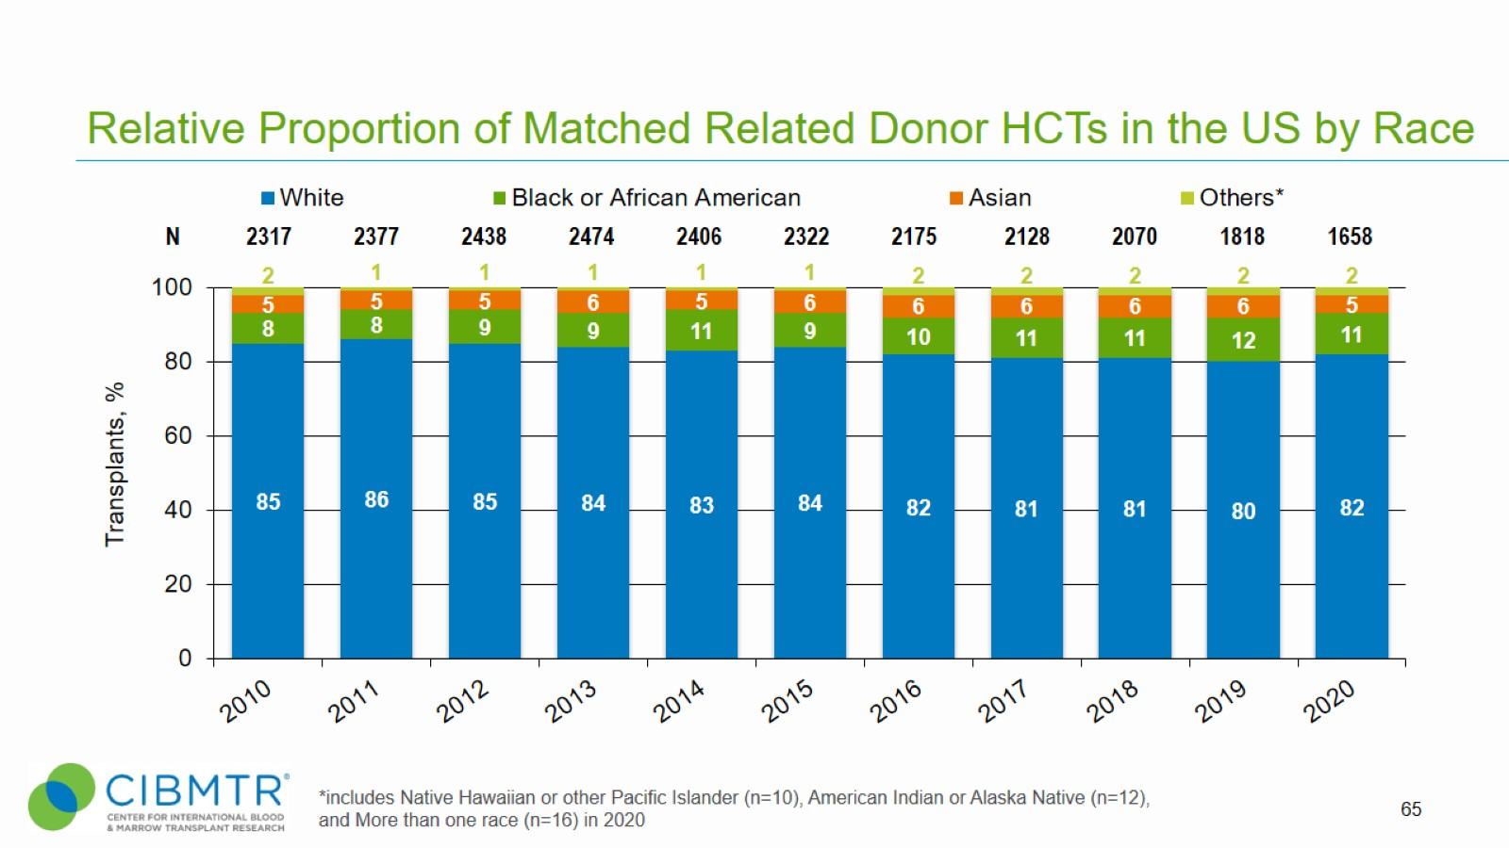
Relative Proportion of Matched Related Donor HCTs in the US by Race
Notes:
Slide 65: Trends in MRD HCT by race are stable over time

Slide 14
Relative Proportion of Matched Unrelated Donor HCTs in the US by Race
Notes:
Slide 66: Trends in MUD HCT by race are stable over time

Slide 15
Relative Proportion of Haploidentical Donor# HCTs in the US by Race
Notes:
Slide 67: Trends in Haplo HCT show a higher proportion of patients in groups other than white receiving an HCT using this donor type than in allo HCT overall

Slide 16
Relative Proportion of Mismatched Unrelated Donor HCTs in the US by Race
Notes:
Slide 68: Trends in MMUD HCT show a higher proportion of patients in groups other than white receiving an HCT using this donor type than in allo HCT overall

Slide 17
Relative Proportion of Cord Blood Allogeneic HCTs in the US by Race
Notes:
Slide 69: Trends in Cord blood HCT show a higher proportion of patients in groups other than white receiving an HCT using this donor type than in allo HCT overall

