Slide 1
Current Uses of CAR T-cell Therapies in the US
2021 Cellular Therapy Summary Slides
Notes:
INTRODUCTION: The CIBMTR launched the cellular therapy (CT) registry in 2016 with the objective of capturing demographic, patterns of use and outcomes of recipients of cellular therapies. Similar to the hematopoietic cell transplant (HCT) outcomes database, the CT registry captures long term outcomes of recipients of these therapies and it can be used to meet regulatory requirements for 15 years of follow up, applicable to recipients of genetic modified cellular therapies. Currently, there are six chimeric antigen receptor (CAR) T-cells commercially approved for treatment of five hematologic malignancies, large B-cell lymphoma, mantle cell lymphoma, follicular lymphoma, acute lymphoblastic leukemia and multiple myeloma.
The CT infrastructure is being used to capture real-world data of recipients of CAR T-cells and this report provides an early look of the implementation of these therapies in the US. Data collection for CAR T-cells is voluntary and the capture of the overall activity of these therapies in the US by the CIBMTR is estimated to be 65% of commercial products. This estimate is based on reconciling the number of products delivered to centers and the subsequent reporting to the CIBMTR, using product identifiers.
The third edition of these Summary Slides outlines accrual numbers, indications, demographic information voluntarily reported by US centers on recipients of CAR T cells from 2016 to 2021. The majority of cases being reported are from centers utilizing commercially available CAR T cells for treatment of approved indications. Data capture for 2021 is ongoing and total numbers presented here are not final.
Moskop, A, Jacobs B, Pasquini MC. Current uses of CAR T cell Therapies in the US: CIDR summary slides, 2021. Available at: http://www.cibmtr.org

Slide 2
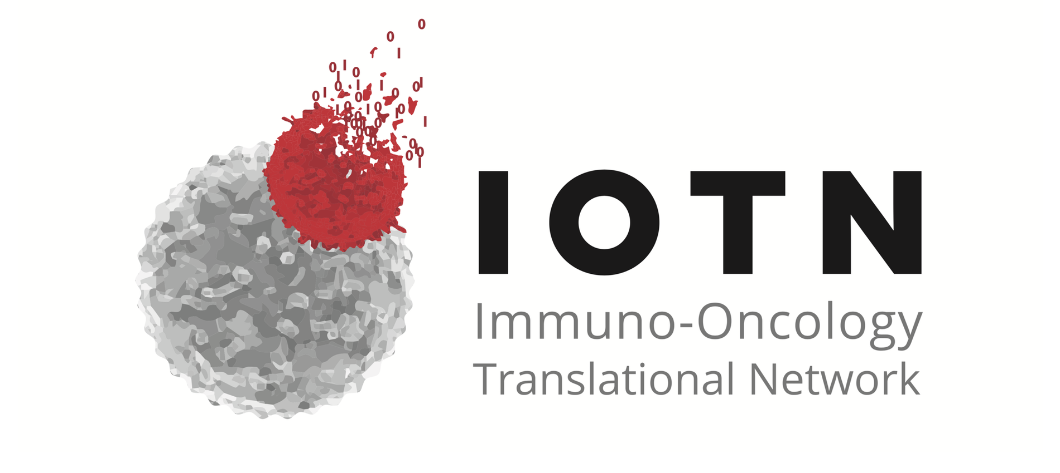
Cellular Immunotherapy Data Resource (CIDR)
Program funded by the US National Cancer Institute to support the Immuno-Oncology Translational Network (IOTN) and the biomedical community as a resource
Provides an infrastructure for data collection, verification and management for cellular therapies across multiple sources
Goal is to facilitate observational and correlative research
Notes:
​Slide 2: In 2016, the National Cancer Institute awarded CIBMTR a grant to operate the Cellular Immunotherapy Data Resource (CIDR). This is part of the Cancer Moonshot℠ to accelerate cancer research, under the Immuno-Oncology Translational Network (IOTN). The Cancer Moonshot℠ helps scientists in different organizations nationwide to join and quickly develop new immune therapies to prevent or cure cancer. The CIDR collects data about the long-term safety and efficacy of these cellular therapies. In addition, it provides an infrastructure for data collection, verification, and management for cellular therapies. Congruent with CIBMTR practices, the CIDR grant enables development of data reporting strategies, management the Cellular Therapy Registry, identification of alternative approaches to capture and share data, and optimization of sharing of de-identified data with the stakeholders and the public. The goal is to facilitate observational and correlative research for the rapidly expanding field.

Slide 3
Timeline and Milestones of CT Registry
Japanese Platform to capture CT Data
Approval of Kymriah
NCI funded CT Registry Pilot
Approval of Yescarta
Approval of Tecartus
Approval of Breyanzi
Establish the CT Task Force
Approval of Abecma
2015
2016
2017
2018
2019
2020
2021
2022
CIBMTR LTFU for Tisagenleclecel
Launch of the Cellular Therapy Registry
CIBMTR LTFU for Axi-cel
LTFU for Brexu-cel
LTFU for Liso-cel
LTFU for Ide-cel
Notes:
Slide 3: This slide outlines the timeline and milestone for the CT registry development. As highlighted in previous Summary Slides, this program started in 2015 with the development of a CT Task Force to assess the CT landscape and to start the development of common data elements pertinent to this field. Through initial funding by the National Cancer Institute (NCI), the CT registry was launched in 2016 and the registry has collected data uninterrupted since that time. The CIBMTR, European group for Blood and Marrow Transplantation (EBMT) and the Japan Data Center for Hematopoietic Cell Transplantation (JDCHCT) worked to harmonize their forms to maximize the standardization of data collection. After the commercial approval of Tisagenlecleucel and Axicabtagene Ciloleucel, CIBMTR worked with Novartis and Kite Pharma to develop post approval safety studies (PASS) to use the CT registry as the infrastructure for the long term follow up of recipients of these therapies. Subsequent commercial approvals of brexucatagene-autoleucel for treatment of mantle cell lymphoma, lisocabtagene maraleucel for large B-cell lymphoma and idecabtagene vecleucel for multiple myeloma also led to the development of post approval studies for regulatory assessment of these agents in the real-world setting.
In January 2020 over 2000 CAR T cell recipients were reported to the CT registry and the Axicabtagene Ciloleucel PASS completed accrual in July 2020.

Slide 4
CAR T cell Post Approval Studies for LTFU
Project | Sponsor | Objective | Timeline/Duration
Yescarta LTFU (Axicabtagene ciloleucel) | Kite | Safety and efficacy outcomes (PASS) N=1,800 (Current 1500 LBL, 170 FL) Diseases: DLBCL (1500), FL (300) | 07/2018 4 years of accrual 15 years of follow up
Kymriah LTFU (Tisagenlecleucel) | Novartis | Safety and efficacy outcomes (PASS) N=2,500 (Current N=1950) Diseases: DLBCL (1500) and ALL (1000) | 08/2018 5 years of accrual 15 years of follow up
Breyanzi LTFU (Lisocabtagene maraleucel) | BMS | Safety and efficacy outcomes (PASS) N=1,000 (Current N=185) Disease: DLBCL | 02/2021 5 years 15 years of follow up
Abecma LTFU (Idecabtagene vecleucel) | BMS | Safety and efficacy outcomes (PASS) N=1,000 (Current N=316) Disease: Multiple Myeloma | 03/2021 3 years 15 years of follow up
Tecartus (Brexucatagene autoleucel) | Kite | Safety and efficacy outcomes (PASS) N=1000 (Current, MCL N=330, ALL N=25) Disease: Mantle Cell Lymphoma (500), ALL (500) | 07/2020 3 years 15 years of follow up
Carvytki Ciltacabtagene autoleucel | Janssen/Legend | Safety and efficacy outcomes (PASS) N=1500 Disease: Multiple Myeloma | 03/2022 3 years 15 years of follow up
Notes:
Slide 4: This slide summarizes the industry-sponsored projects for all commercially approved CAR T-cell therapies in the US. There are currently 6 post approval safety studies (PASS) including Axicabtagene Ciloleucel, Tisagenlecleucel, Lisocabtagene maraleucel, Brexucatagene autoleucel, Idecabtagene vecleucel and ciltacatagene autoleucel. The Axicabtagene Ciloleucel PASS completed accrual for the diffuse large B-cell lymphoma cohort in July 2020 with 1500 patients and since then it label expanded to include patients with follicular lymphoma which added 300 more patients to this study. Similarly, Brexucabtagene autoleucel’s label expanded to include treatment of adult patients with acute lymphoblastic leukemia. The accrual goal, current status and timeline of each PASS is detailed above.

Slide 5
Number of CAR T cell infusions: 2016-2021 (6,343 patients and 6,624 infusions)
Cumulative
Notes:
Slide 5: Annual and cumulative accrual to the CIDR of patients in 2021 reached close to 2000 patients. Total accrual is 6,343 CAR T cell recipients and 6,624 infusions.

Slide 6
CAR T Cell Indications: 2016-2021 (N=6,343)
Centers: 195 (US 95%)
Median age: 61 y (<1-91)y
Prior HCT: 33%
Notes:
Slide 6: The most common indication for CAR T cells is large B-cell lymphoma, followed by acute lymphoblastic leukemia and multiple myeloma. The majority of CAR T cells captured in the CIDR are commercial with 14% of reporting non-commercial CAR T cells. There are 195 reporting centers from US, Canada and Israel.

Slide 7
Commercial CAR T cell Indications Annually: 2017-2021
Notes:
Slide 7: Annual number of CAR T cell recipients by indication clearly demonstrates the expansion to new indications . There is a rapid expansion of CAR T cells being used for mantle cell lymphoma and multiple myeloma aligning with the recent approvals.

Slide 8
Prior HCT to CAR T-cell by Indication: 2017-2020
Notes:
Slide 8: Practice patterns from 2017 to 2021 related to patient selection have evolved. Overall, the proportion of patients with a prior hematopoietic cell transplant 33%, however this proportion has been rapidly changing in the last 5 years. The proportion of patients who did not receive an HCT prior to CAR T-cell therapy is steadily increasing with 84% and 81% of patients with ALL and NHL without a prior HCT in 2021, respectively. This trend demonstrates an evolution in patient selection by overing a CAR T cell earlier in the course of the disease, leaving a transplant option for later.

Slide 9
Distribution of CAR T-cell Recipients by Age and Commercial Product (N=4,094)
Notes:
Slide 9: This slide illustrates the age distribution of CAR T-cell recipients. Among recipients of commercial CAR T-cells, 38% are 65 years or older, which is increasing with the number of approved indications that frequently in older adults such as multiple myeloma and follicular lymphoma in addition to the increased use for treatment of large cell lymphoma. The proportion of patients 65 years and older who received noncommercial CAR T-cells is 28%, likely due to a higher proportion of clinical trial participants in this group. The CAR T-cells represented in the noncommercial group include recipients of CAR T-cells under investigator-initiated studies of approved or otherwise products, or patients who receive CAR T-cells as part of expanded access protocols voluntarily reported by participating centers. Further identification of these studies is done through clinicaltrials.gov identifier number collected in the CT forms.

Slide 10
CAR T-Cell Indications Annually: 2016-2021
Notes:
Slide 10: CAR T-cell indications by year demonstrates an increase in the overall utilization of this therapy consistent with commercial approval of the products. There is a more distinctive increase among recipients with large B-cell lymphoma with over 1200 patients treated for this indication being reported in 2021. All new indications on recent approved CAR T cells are also expanding in utilization since 2020.

Slide 11
CAR T-cell by recipient’s race: 2016-2021
Notes:
Slide 11: The distribution of race and ethnicity of CAR T-cell recipients from 2016 to 2021 demonstrate that 79% of recipients are Caucasians and 78% are non-Hispanic or non-Latinos. Minority groups remain underrepresented among recipients of these therapies according to data reported to the CIBMTR. There is small proportion of non-US patients who received the therapy in the US but did not report race or ethnicity.

